Slide 1

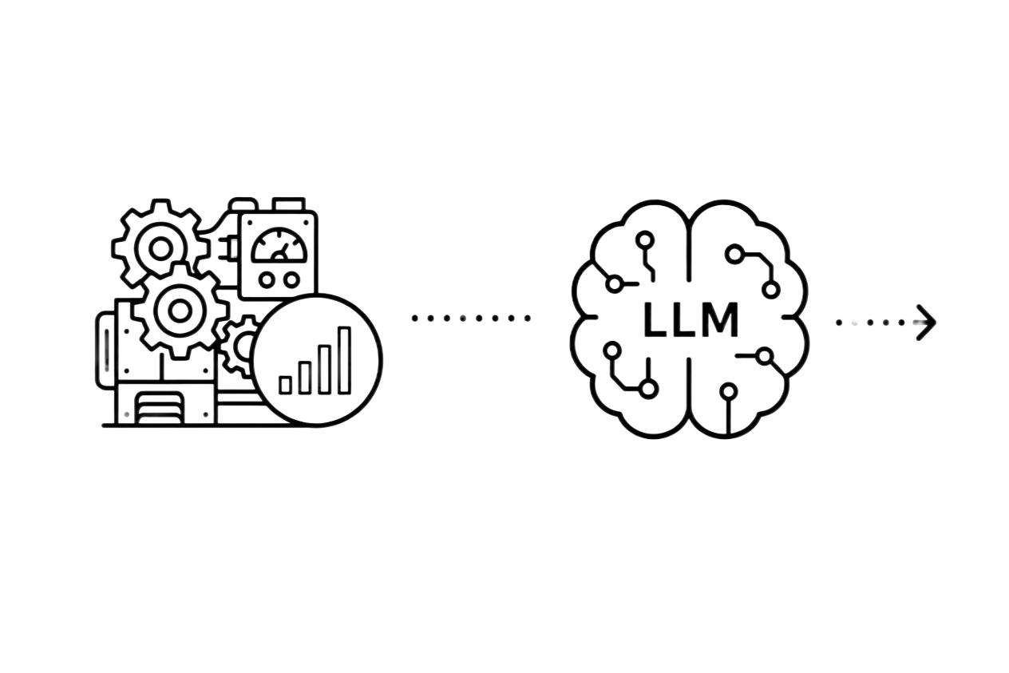
FMN MDPR Intelligence
Project 2 Submission
by Ime Inyang
Notes:
I’ve written a book for kids in tech. It’s titled “A Kid’s Guide To Change The World”.
During the editing phase, I asked someone to review the book. She was quite occupied, so she suggested that I used ChatGPT.
It was a good suggestion, but I declined to follow through why?
The problem was not data privacy or data assimilation. My problem was trust.
LLMs are typically sycophantic. So how can you really trust what they say?
And when they make corrections, the corrections can be unending, unless you provide clear guidelines. But even then, it can yap a lot about unnecessary details.
So how can you trust a talkative?
Or when your child asks Gemini a math question, how can you ensure they don’t get an F in their assignment?
Or how can you trust it to tell you about current stock prices, and not mistake that query as an inventory request.

Slide 2
The Problem
A machine rarely fails without warning.
The problem is seeing the warning early enough to act.
TODAY
The gap
🔴 BREAKDOWN
Production stops → lost output → emergency repairs
🟡 REACTIVE MAINTENANCE
Technicians respond after the problem becomes obvious
⚪ OPAQUE ALARMS
Lots of sensor data, but little explanation of what needs attention and why
Which machines are degrading right now — and which ones need attention first?
Notes:
Like I said, foundation models are incredibly good at sounding intelligent.
That’s what makes them both powerful and dangerous.
An AI assistant can confidently provide a completely incorrect answer, fabricate information, or follow instructions it should ignore, while still sounding convincing.
And when we embed these models into enterprise applications, or internal knowledge assistants, the impact becomes much larger.
The challenge is that many users naturally associate confidence with reliability. Yesterday, I explained about highschoolers who were developing a solution and said they “asked AI”. They did no verification beyond what the model fed them.
And you see, unlike traditional systems that fail visibly (like a windows error pop-up), LLMs can fail invisibly.
So this behavior should change how we think about software quality, testing, and trust.

Slide 3
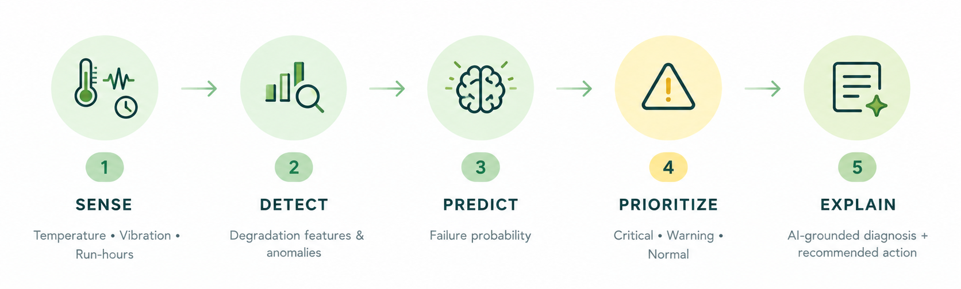
MDPR Intelligent Dashboard
Turning telemetry into an early warning system
The goal isn't more sensor data. It's earlier decisions.
Notes:
Like I said, foundation models are incredibly good at sounding intelligent.
That’s what makes them both powerful and dangerous.
An AI assistant can confidently provide a completely incorrect answer, fabricate information, or follow instructions it should ignore, while still sounding convincing.
And when we embed these models into enterprise applications, or internal knowledge assistants, the impact becomes much larger.
The challenge is that many users naturally associate confidence with reliability. Yesterday, I explained about highschoolers who were developing a solution and said they “asked AI”. They did no verification beyond what the model fed them.
And you see, unlike traditional systems that fail visibly (like a windows error pop-up), LLMs can fail invisibly.
So this behavior should change how we think about software quality, testing, and trust.

Slide 4
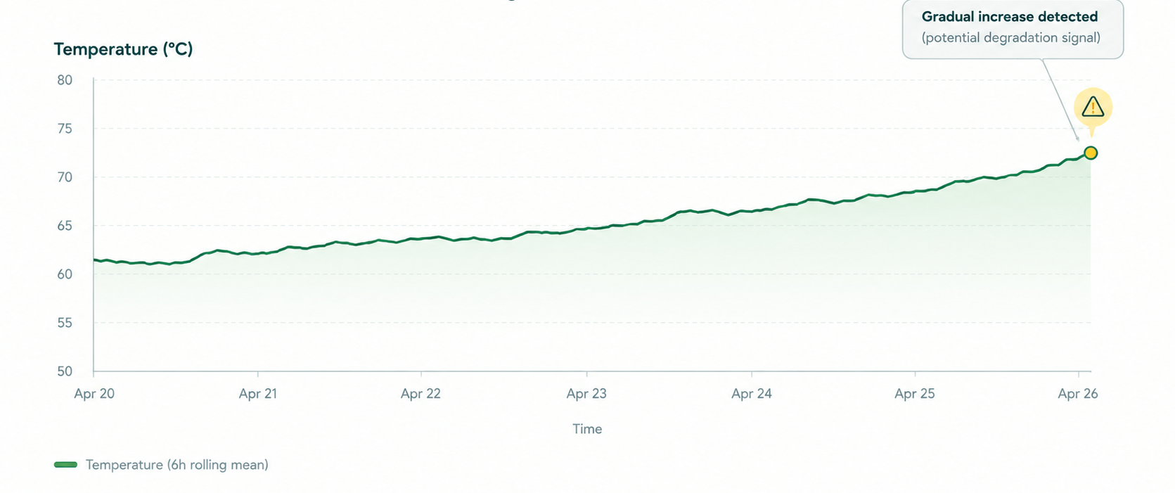
What Does "Degrading" Actually Look Like?
Not high readings, but change.
A single reading may look normal. The trend tells a different story.
Notes:
Like I said, foundation models are incredibly good at sounding intelligent.
That’s what makes them both powerful and dangerous.
An AI assistant can confidently provide a completely incorrect answer, fabricate information, or follow instructions it should ignore, while still sounding convincing.
And when we embed these models into enterprise applications, or internal knowledge assistants, the impact becomes much larger.
The challenge is that many users naturally associate confidence with reliability. Yesterday, I explained about highschoolers who were developing a solution and said they “asked AI”. They did no verification beyond what the model fed them.
And you see, unlike traditional systems that fail visibly (like a windows error pop-up), LLMs can fail invisibly.
So this behavior should change how we think about software quality, testing, and trust.

Slide 5
Why HistGradientBoosting?
For maintenance, missing a failure is worse than raising a false alarm.
Model | Precision | Recal
Random Forest | 50% | 33.3%
Isolation Forest | 1.5% | 33.3%
PCA | 1.2% | 33.3%
HistGradientBoosting✓ | 30% | 100%
100% Recall
Decision threshold
→ preserves 100% recall
→ reduces unnecessary alerts compared with a lower-confidence operating strategy
0.80 failure probability
Every failure in the evaluation window was detected.
Notes:
Like I said, foundation models are incredibly good at sounding intelligent.
That’s what makes them both powerful and dangerous.
An AI assistant can confidently provide a completely incorrect answer, fabricate information, or follow instructions it should ignore, while still sounding convincing.
And when we embed these models into enterprise applications, or internal knowledge assistants, the impact becomes much larger.
The challenge is that many users naturally associate confidence with reliability. Yesterday, I explained about highschoolers who were developing a solution and said they “asked AI”. They did no verification beyond what the model fed them.
And you see, unlike traditional systems that fail visibly (like a windows error pop-up), LLMs can fail invisibly.
So this behavior should change how we think about software quality, testing, and trust.

Slide 6
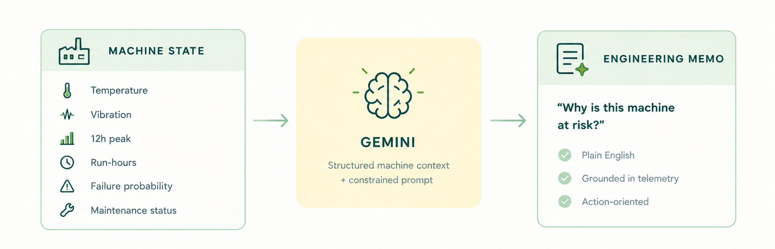
From Red Flags To Relevant Explanations
AI explains the risk
ML predicts the risk. Rules recommend the action. LLM explains the evidence.
Notes:
Like I said, foundation models are incredibly good at sounding intelligent.
That’s what makes them both powerful and dangerous.
An AI assistant can confidently provide a completely incorrect answer, fabricate information, or follow instructions it should ignore, while still sounding convincing.
And when we embed these models into enterprise applications, or internal knowledge assistants, the impact becomes much larger.
The challenge is that many users naturally associate confidence with reliability. Yesterday, I explained about highschoolers who were developing a solution and said they “asked AI”. They did no verification beyond what the model fed them.
And you see, unlike traditional systems that fail visibly (like a windows error pop-up), LLMs can fail invisibly.
So this behavior should change how we think about software quality, testing, and trust.

Slide 7
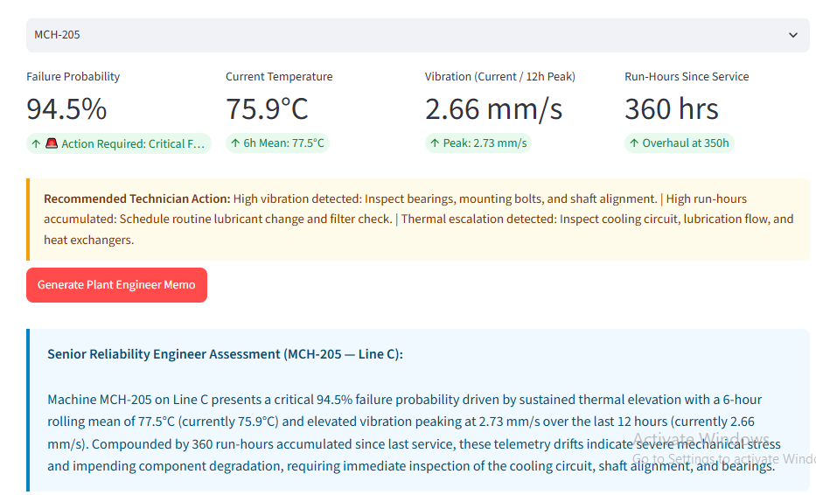
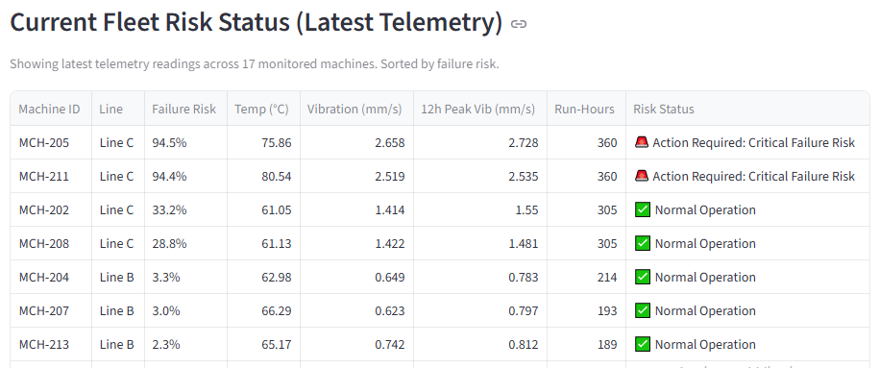
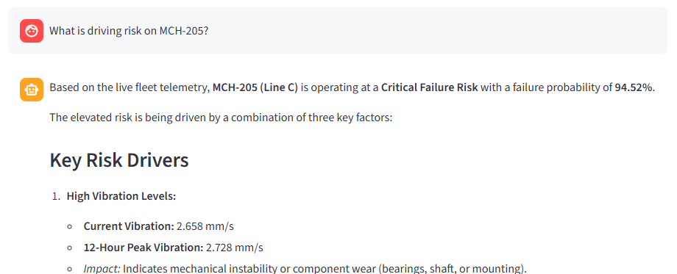
Plant Engineer's View
From 17 machines to one prioritized view
① Prioritize
② Investigate
③ Understand
④ Ask
Notes:
Like I said, foundation models are incredibly good at sounding intelligent.
That’s what makes them both powerful and dangerous.
An AI assistant can confidently provide a completely incorrect answer, fabricate information, or follow instructions it should ignore, while still sounding convincing.
And when we embed these models into enterprise applications, or internal knowledge assistants, the impact becomes much larger.
The challenge is that many users naturally associate confidence with reliability. Yesterday, I explained about highschoolers who were developing a solution and said they “asked AI”. They did no verification beyond what the model fed them.
And you see, unlike traditional systems that fail visibly (like a windows error pop-up), LLMs can fail invisibly.
So this behavior should change how we think about software quality, testing, and trust.

Slide 8
Next Steps
More failure data
collect more run-to-failure data or investigate realistic synthetic failure sequences to improve precision without sacrificing recall.
Smarter data access
give LLM controlled access to telemetry through SQL/vector queries so it can answer questions about specific machines, shifts and anomaly intervals on demand.
Notes:
Like I said, foundation models are incredibly good at sounding intelligent.
That’s what makes them both powerful and dangerous.
An AI assistant can confidently provide a completely incorrect answer, fabricate information, or follow instructions it should ignore, while still sounding convincing.
And when we embed these models into enterprise applications, or internal knowledge assistants, the impact becomes much larger.
The challenge is that many users naturally associate confidence with reliability. Yesterday, I explained about highschoolers who were developing a solution and said they “asked AI”. They did no verification beyond what the model fed them.
And you see, unlike traditional systems that fail visibly (like a windows error pop-up), LLMs can fail invisibly.
So this behavior should change how we think about software quality, testing, and trust.

